Slide 1
Data Collection and Processing Using APEX2, SHELXTL and the Bruker PHOTON 100
Kevin J. Gagnon
kjgagnon@lbl.gov

Slide 2
Outline
Picking a Crystal
Consequences of poor technique
Getting the Most Out of Your Crystal
When at first you don’t succeed…
Managing expectations
When to quit
Data Collection
Coverage vs. time.
Fast scans
Unit Cell Determination
Thresholding
Identifying problems
RLATT
Cell now
Integration
Default parameters
When things go wrong…
Absorption Correction
APEX2 – Scale
Command Line – SADABS
Command Line - TWINABS
XPREP
Determining resolution
Structure Solution
Command Line – XT/ XS
APEX2 – Structure solution – Intrinsic phasing / direct methods
Summary

Slide 3
Picking a Crystal
Notes:
Key points: Try to match crystal size to loop aperature size. (Always favor a smaller loop, never a larger if it can be avoided). Keep an absolute minimum of oil on your loop, you don’t need much just enough for adhesion. Move your crystals to the edge or out of your oil using a tool before picking with the loop.

Slide 4
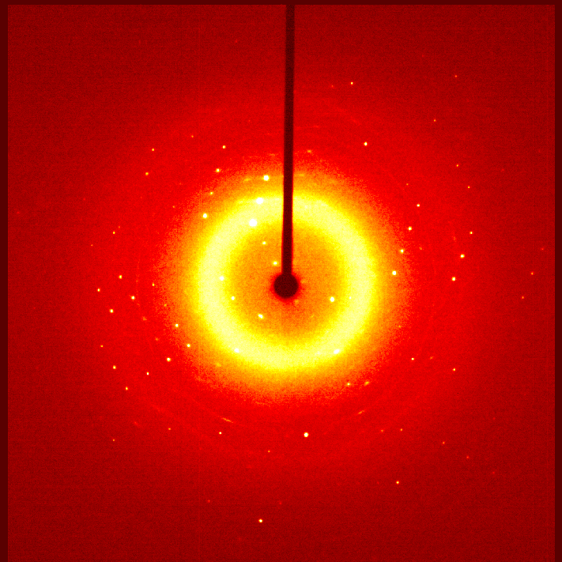
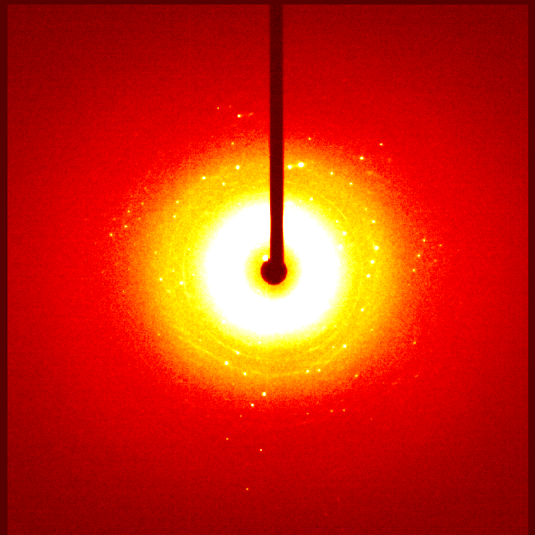
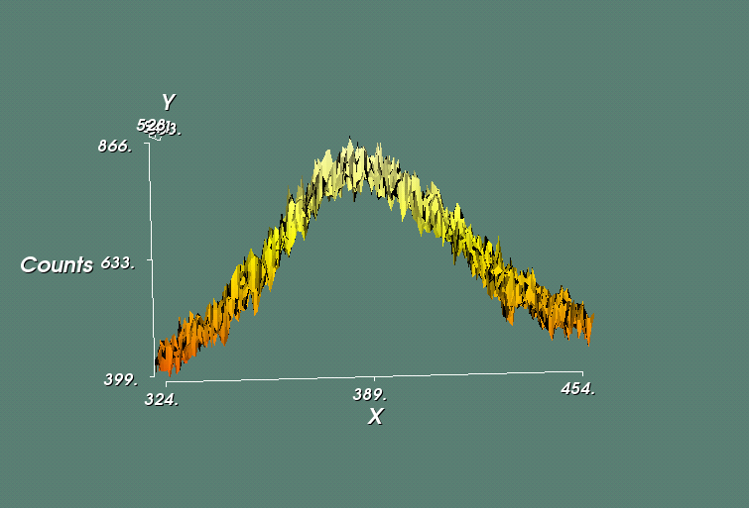
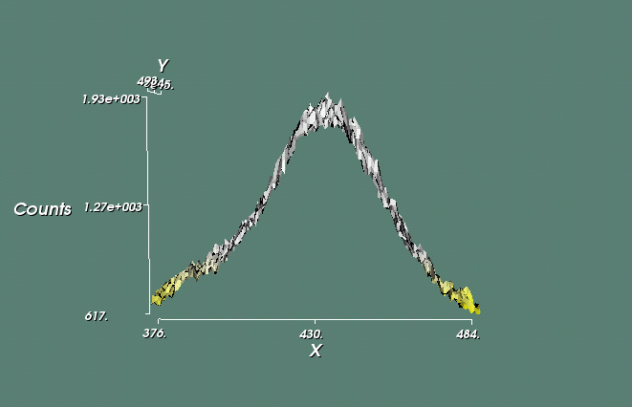
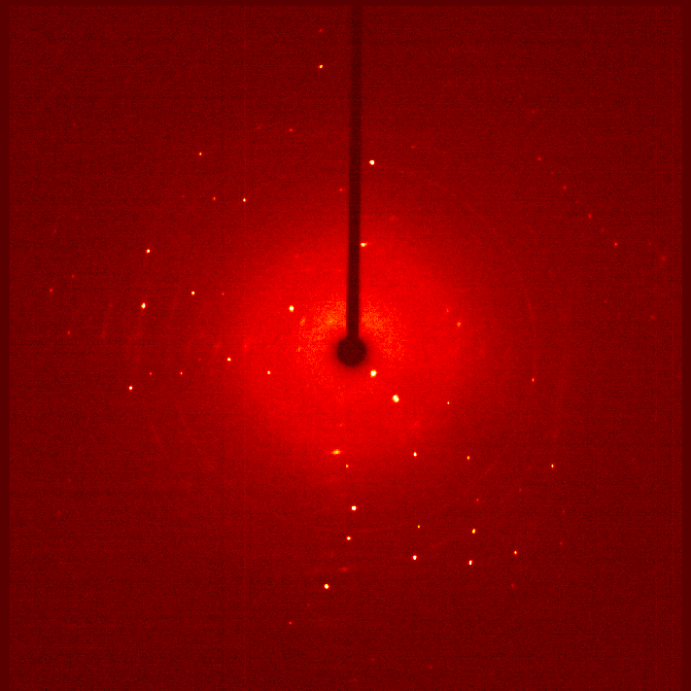
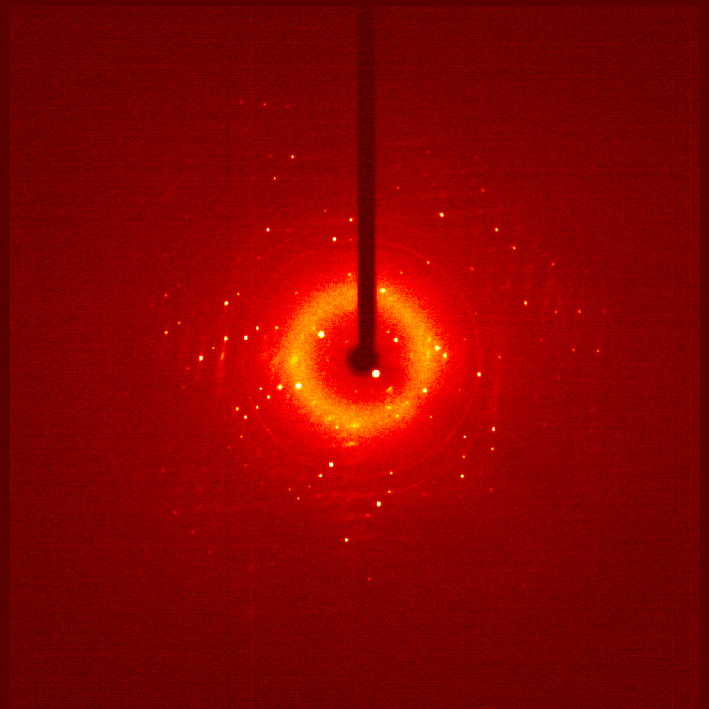
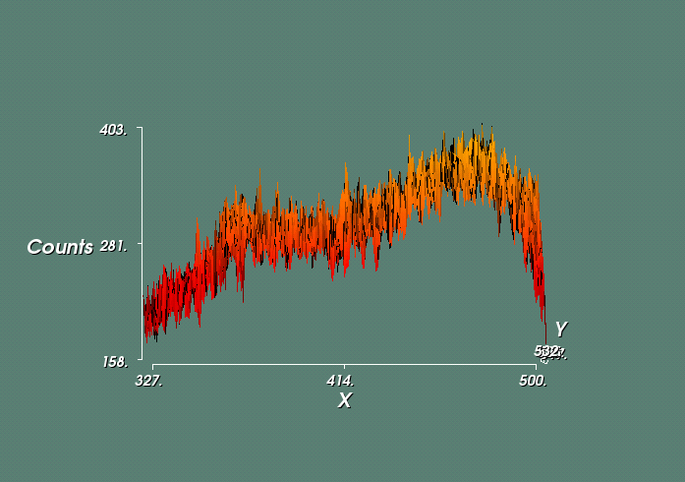
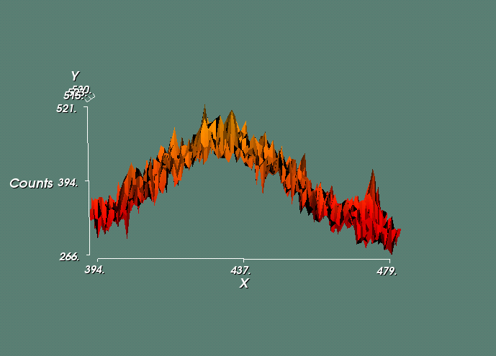
Picking a Crystal
Consequences of poor technique
8 cm
5 cm
Notes:
More oil = higher background. In the low-angle the background can be high enough to dwarf reflections and makes it difficult to get good statistics. If you need to work in a high background situation (i.e. in a capillary, in solvent, in epoxy) you can help smooth out the background by collecting with the detector further back. Because scattering drops off with distance, your amorphous background will drop off faster than your diffraction.

Slide 5
Picking a Crystal
Consequences of poor technique
5cm detector position
8cm detector position
Notes:
The high background problem is clearly demonstrated when looking at the average intensity on a frame during integration.

Slide 6
Data Collection
Notes:
Collecting a full sphere of data is relatively easy. This strategy is a good starting place, and will need to be adjusted if there is desire for higher resolution (i.e. > 0.6), if there is a need for higher redundancy, or if data is collected with a different detector distance. Adjustment of both the Time and Width of scans can be an effective means of adjusting both spot intensity as well as data collection time. Lastly, the “First run” box is not a number representing where in the list of runs to begin. It is a number representing what to label the first run that does begin. The “active” column is used to pick and choose runs and determine the starting place. (i.e. in the above example, line 2 is set to “No” the scan will begin at line 3, but this scan will be called “dataRT_01” not “dataRT_03”)

Slide 7
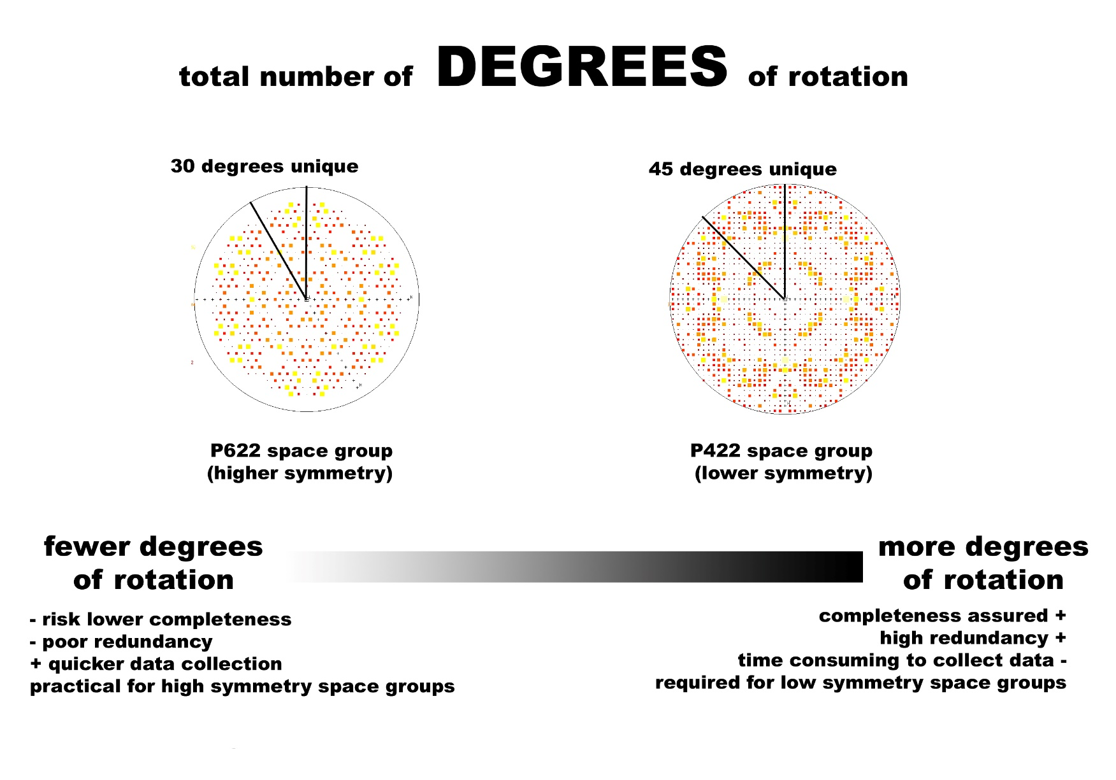
Data Collection
Coverage vs. time
Never make the assumption you know the symmetry from the unit cell alone!
Process the data and determine coverage and completeness before the crystal comes off the diffractometer.
http://people.mbi.ucla.edu/sawaya/m230d/Data/totalframes.jpg
Notes:
Symmetry effects how much data is required to be collected for completeness and redundancy. Higher symmetry = less necessary unique data; however, if you do not confidently know the symmetry of your system (i.e. have not done a refinement on it already) then you should assume it is triclinic and collect a full sphere. This gives you the luxury of throwing data away and prevents having to recollect because you didn’t collect enough data the first time.

Slide 8
Unit Cell Determination
Notes:
Unit cell determination essentially scans through the images and selects spots which are above a user defined intensity/background threshold, it then utilizes the positions of these reflections to determine unit cell lattice parameters and lattice symmetry.

Slide 9
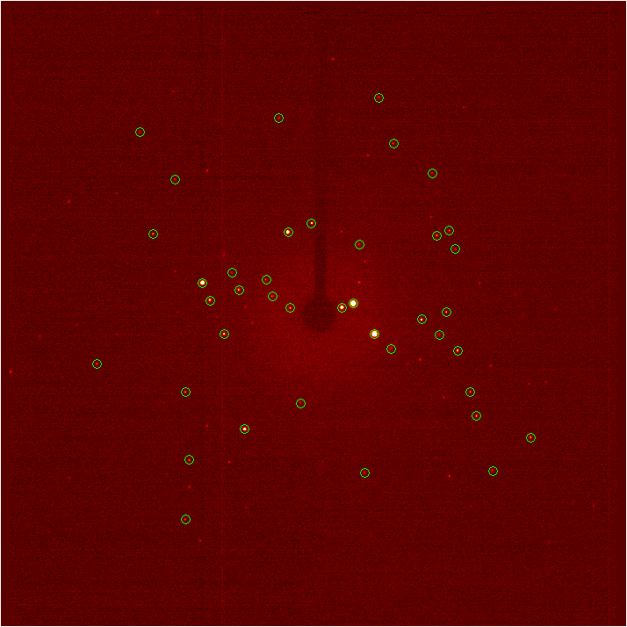
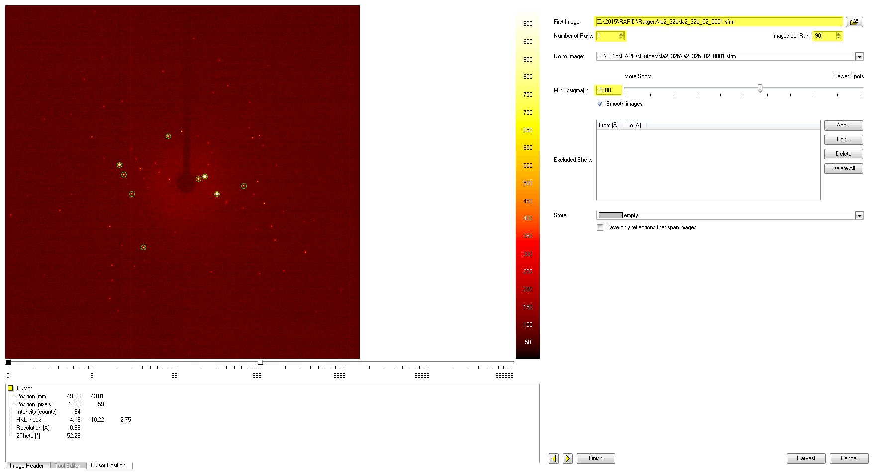
Unit Cell Determination
Threshold
Notes:
Make sure to choose an I/sigma of low enough, such that important weak reflections are not overlooked. Do not choose one so low that noise is harvested. Also, make sure not to harvest from the fast scans, as the width of these frames makes it difficult to accurately determine spot positions. It is recommended to harvest from one run (ideally the on-axis, 2-theta=0 run) so if there are issues (i.e. twinning) you aren’t viewing inconsistencies between runs when trying to visualize the reflections in RLATT.

Slide 10
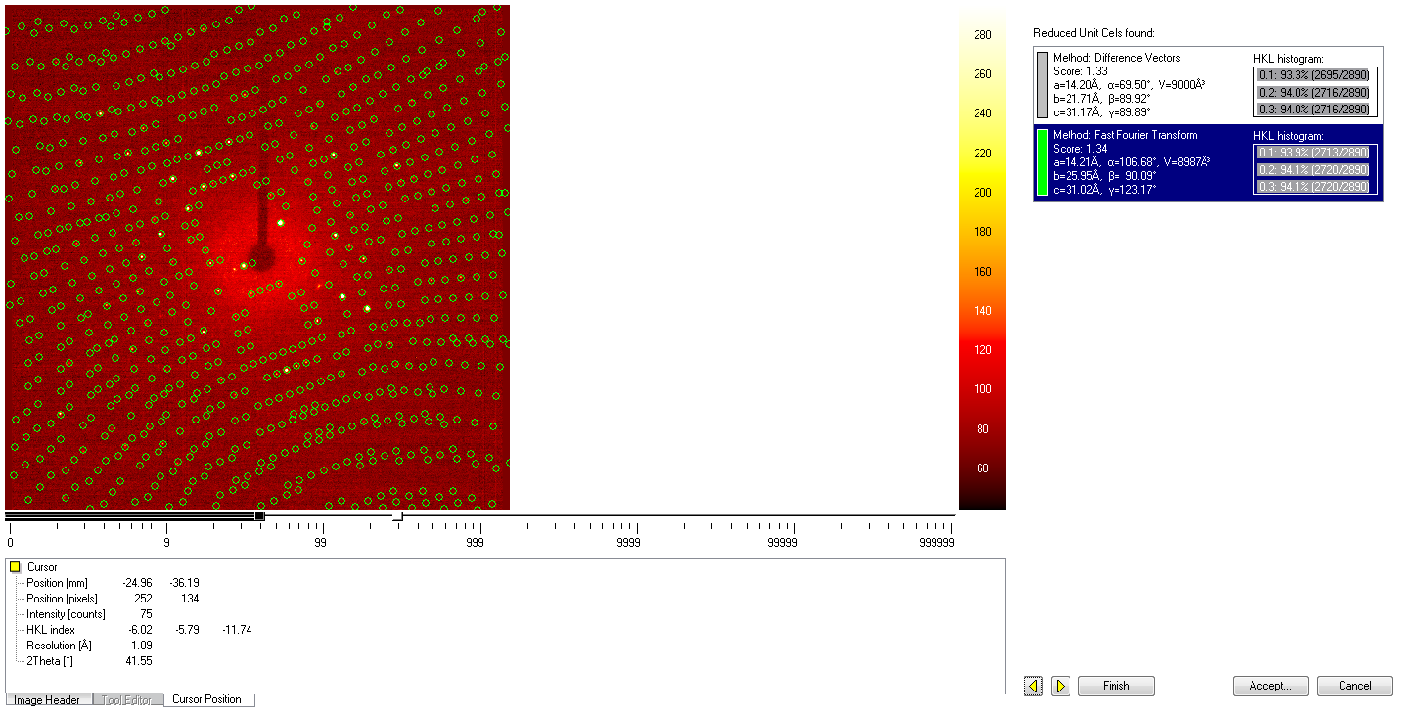
Unit Cell Determination
Identifying problems
Good number of reflection match, but many more predicted spots than actual spots observed.
Poor number of reflections match but predicted spots all lie on a spot. (i.e. 0.1 = 50%, 0.2 = 70%, 0.3 = 80%)
Cell does not make sense for expected system
Two cells appear drastically different (doubled cell, or no way to transform from one to the other)
Failed to find a cell
Notes:
This example shows a very good reflections fit (>90%) however many more predicted spots than observed spots. This is a red flag.

Slide 11
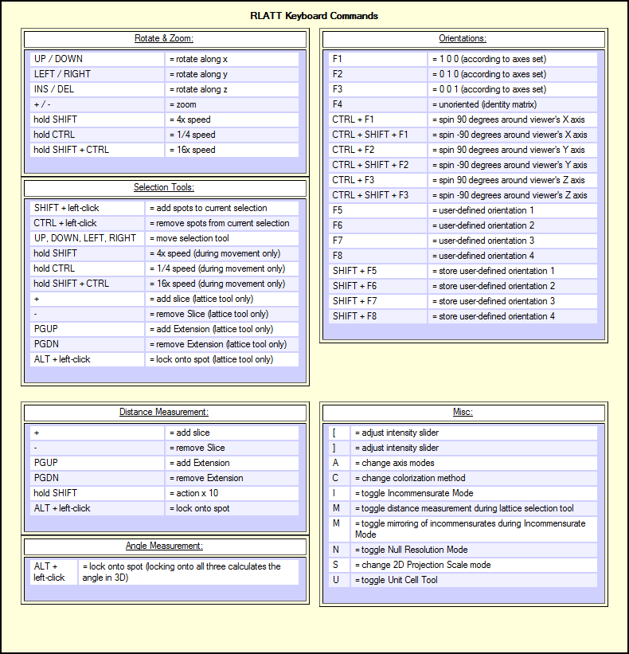
Unit Cell Determination
RLATT
Notes:
Explore RLATT. Check the “RLATT” menu at the top and go through the different subsections to see what they do. Some can be really useful. If you click on the help tool, you can then click on various boxes and sections to see what they are for. If you click with the help tool in any blank space between section frames, you’ll get the keyboard commands window to pop up and makes navigating RLATT much easier.

Slide 12
Unit Cell Determination
Cell now
Command line program, run from your work folder.
Call cell_now –t from command line, the –t flag allows cell now to output your reflections in different groups to be viewed in different colors back in APEX2.

Slide 13
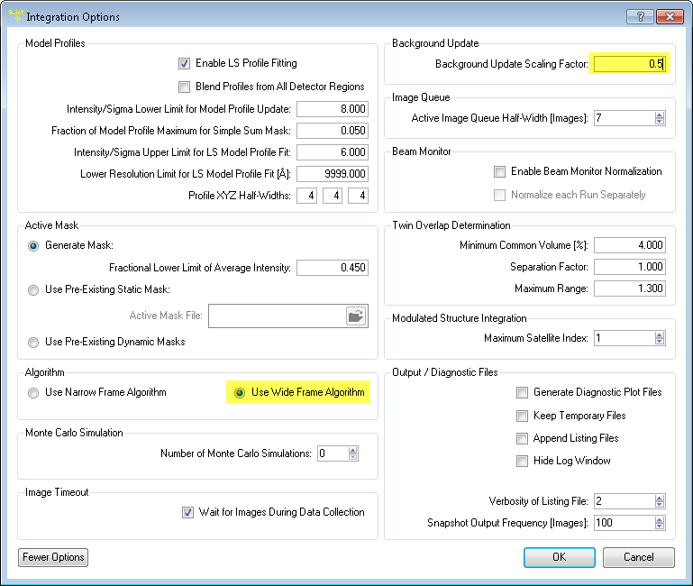
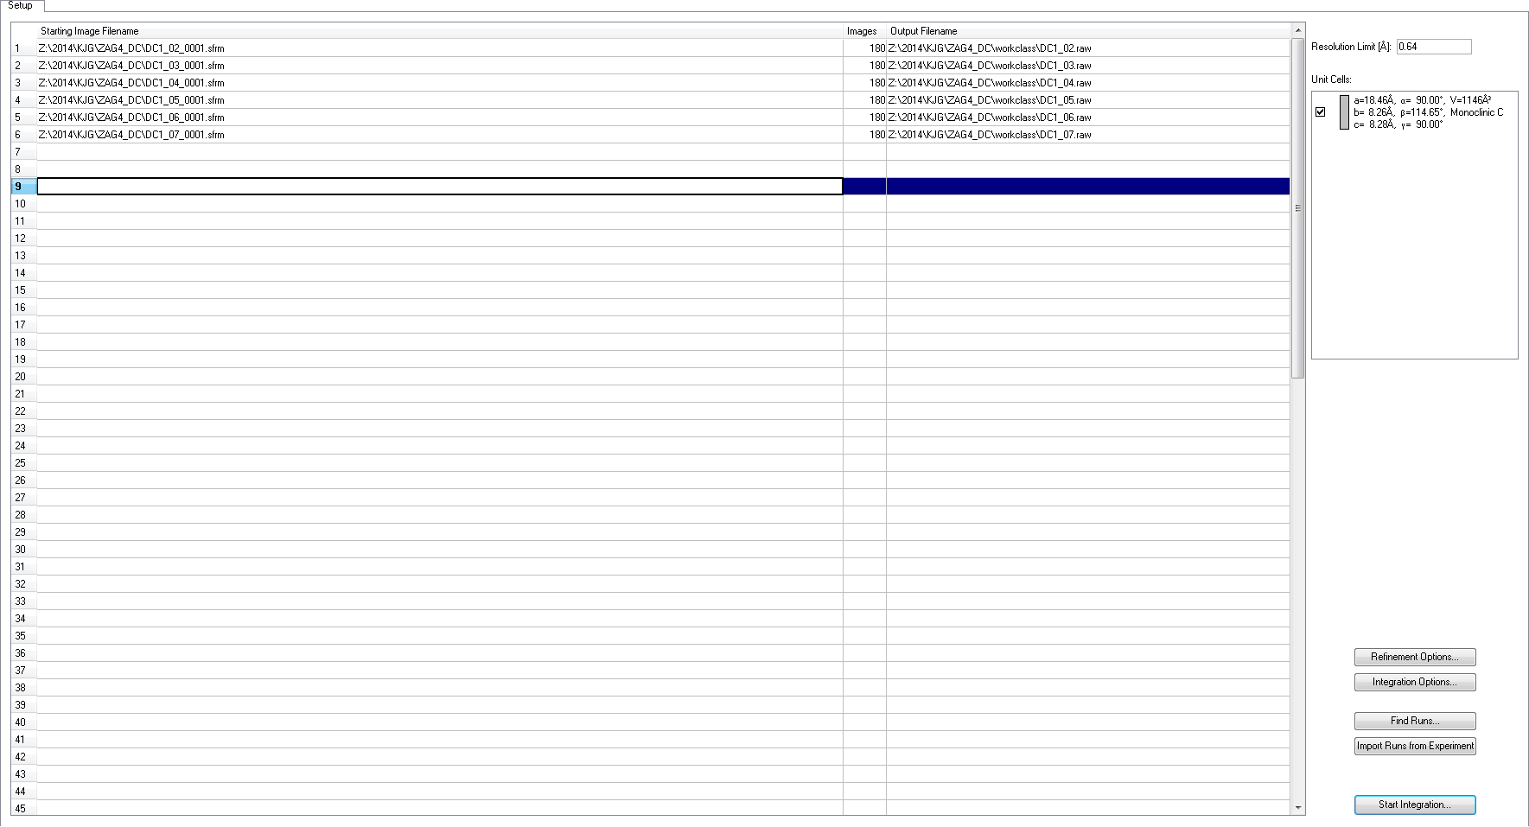
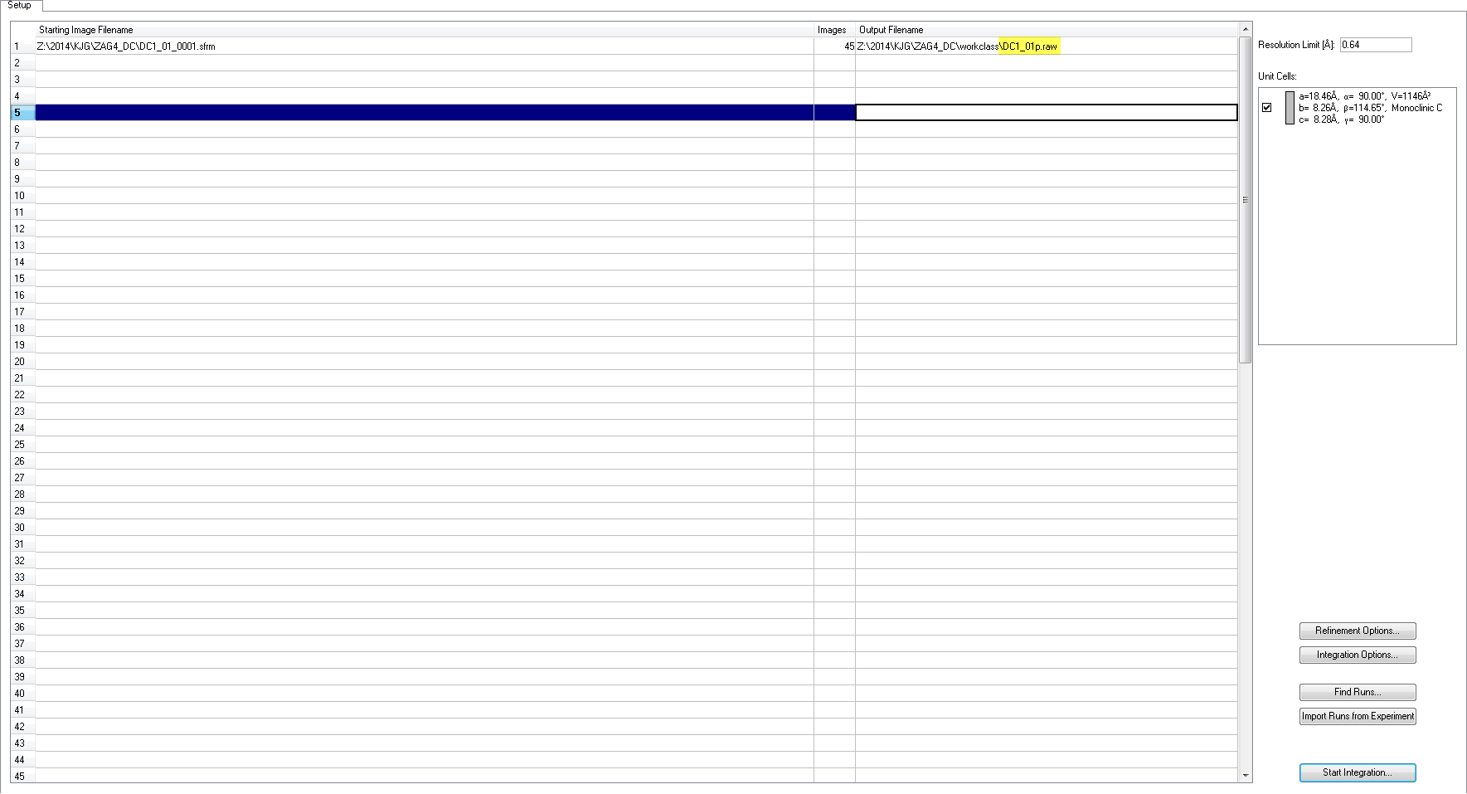
Integration
Notes:
Order of events here: 1. Check the default options in Refinement Options and Integration Options are set properly. 2. Integrate non-fast scans together to a reasonably high resolution (don’t accidently trim data by not setting the resolution high enough) 3. Process integrated data through sadabs (as triclinic) to XPREP and determine the true resolution based on Rmerge statistics (see slide further down). 4. Import the _0m.p4p file back into APEX2 and update the resolution to the new resolution and integrate again. 5. Reimport the _0m.p4p file and run one more integration. 5. Delete the runs from the run list, and “Find runs” and add back the fast scan(s). Rename the output filename for the fast scan to identify it and prevent overwriting of your _0m.p4p file. (I suggest adding a p or an f to the end of the filename before the .raw (i.e. data_01.raw -> data_01p.raw). 6. Open integration options and click more, change the algorithm to Wide Frame, and change the background update scaling factor to 0.5. Run the integration one last time.

Slide 14
Integration
Files Created:
*.raw (.mul or .ram)
These are the reduced format files of your data.
*._ls
These files contain the summary information of the integration. Important information is contained within.
*0m.p4p
This is the updated file containing unit cell information as well as orientation information.

Slide 15
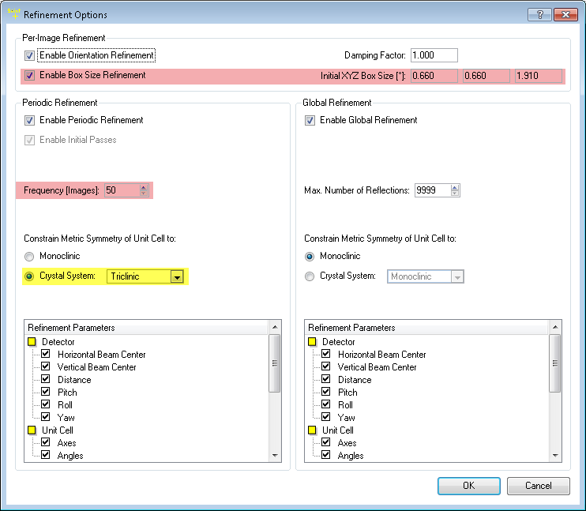
Integration
Default parameters
Notes:
Make sure to set the constrain metric symmetry to Triclinic. If you are having troubles with your integration (i.e. the box size is getting very large, or the correlation runs away at different areas, or it just plain quits in the middle of a run.) you can try lowering the frequency of images (to chase a moving crystal) or disabling the box size refinement (to handle overly streaky data).

Slide 16
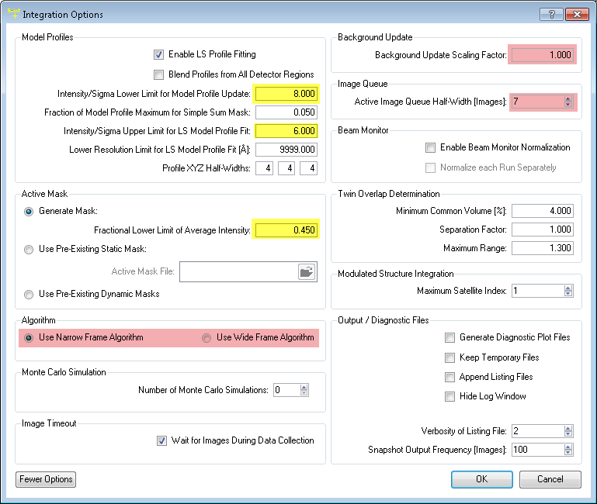
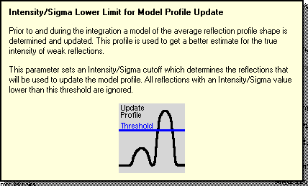
Integration
Default parameters
Notes:
The defaults in APEX 2 for the “Intensity/Sigma Lower Limit…” and “Intensity/Sigma Upper Limit” are 10 and 8 respectively. When utilizing the PHOTON one should reduce these to 8 and 6. If your data is exceptionally weak, you can try making other adjustments to these values. They affect which spots to use to determine spot shape, and also which method for intensity calculation to use based on I/sigma. You also might find with some detectors and some datasets that the Blend Profiles may help. (i.e. if you have a lot of frames that have very very intense reflections in one area and very weak in another area.) Make sure to switch to Wide Frame and change the background scaling factor to 0.5 if your runs have scan widths > 2.

Slide 17
Integration
When things go wrong
Notes:
You can also cut bad frames out if you have the luxury of removing data. To do this, drag the cursor along one of the plots to get a reading of the frame where a problem begins and ends. Then in your run list during the integration setup, split that run into two runs. (i.e. if the problem is in Data_01, and occurs at frame 70 and ends at frame 110. Split your Data_01 into two integration runs, one starting at Data_01_0001.sfrm and continuing for 70 frames. The other start at Data_01_0110.sfrm, and then right click on the numbers on the left side of the table and choose “count images” for it to input the correct number of frames to the end.) This will generate a data_01a and data_01b.raw output files.

Slide 18
Absorption Correction
SADABS provides useful diagnostics and can correct for errors such as variation in the volume of the crystal irradiated, incident beam inhomogeneity, absorption by the crystal support (e.g. when the goniometer head passes under the collimator during an omega scan on a Bruker Platform goniometer), and crystal decay, as well as improving the esds of the intensities, so it is strongly recommended that it is used to process ALL data, whether or not absorption is significant. These corrections also enable larger crystals to be used for weakly diffracting crystals without introducing systematic errors; for an impressive example, see C.H. Görbitz, Acta Cryst. B55 (1999) 1090-1098.

Slide 19
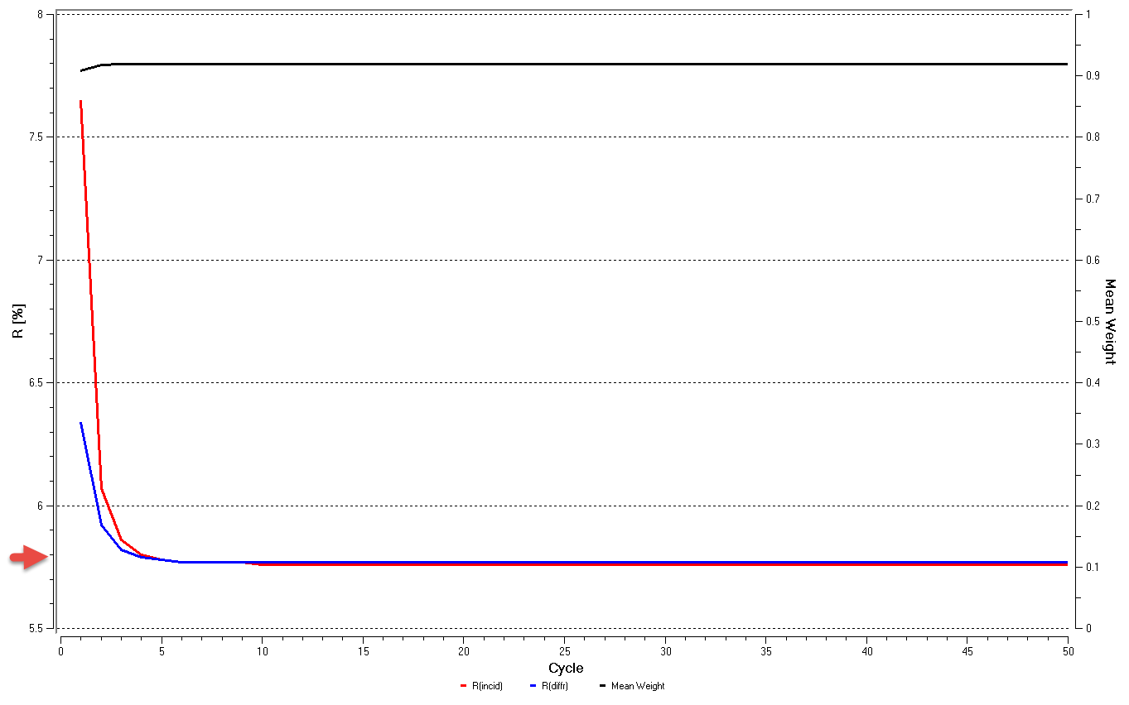
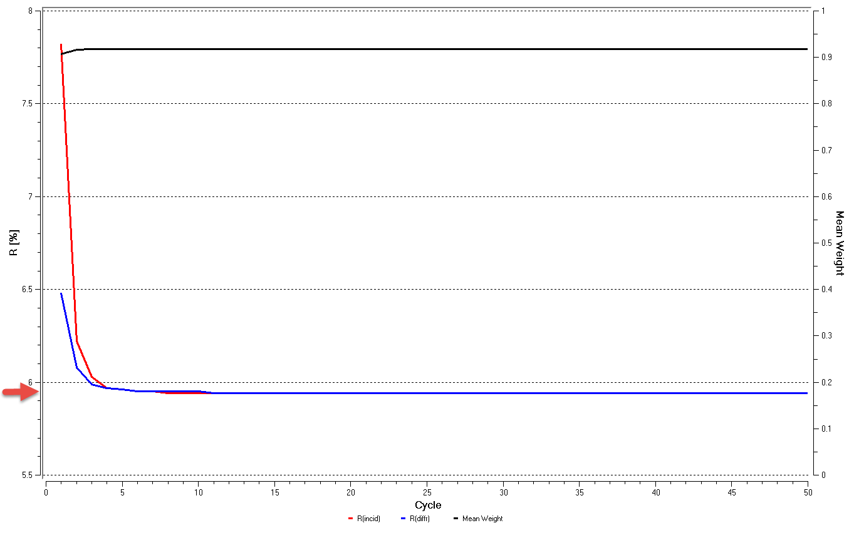
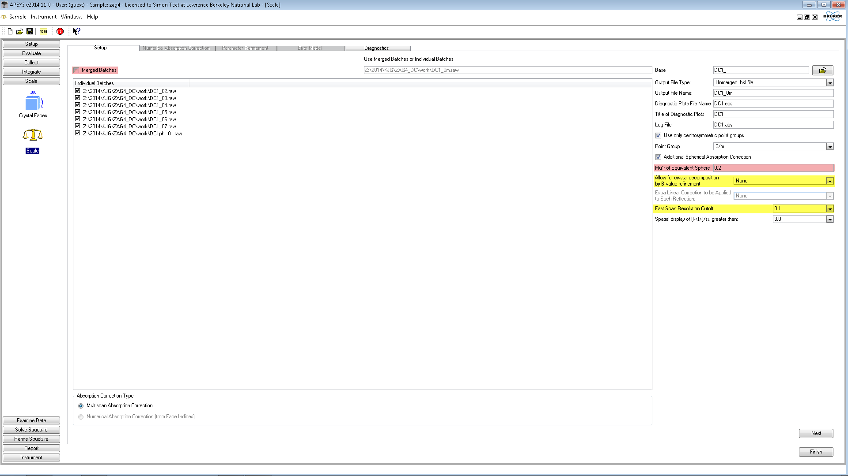
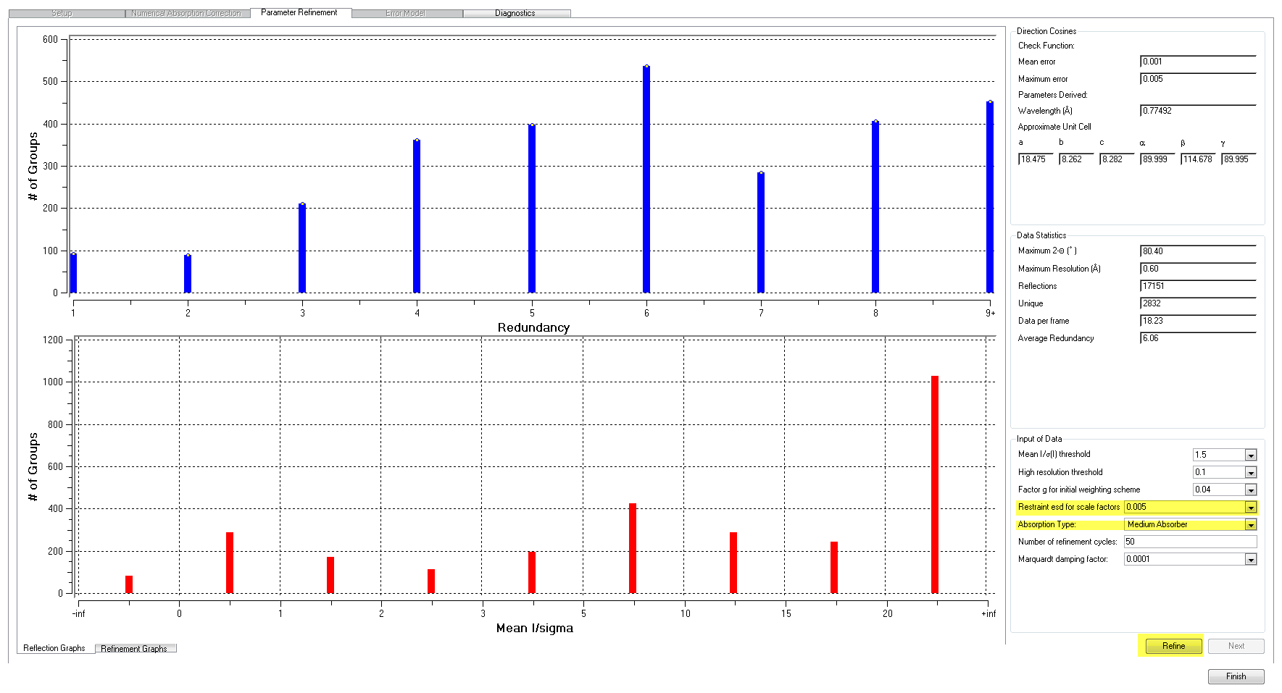
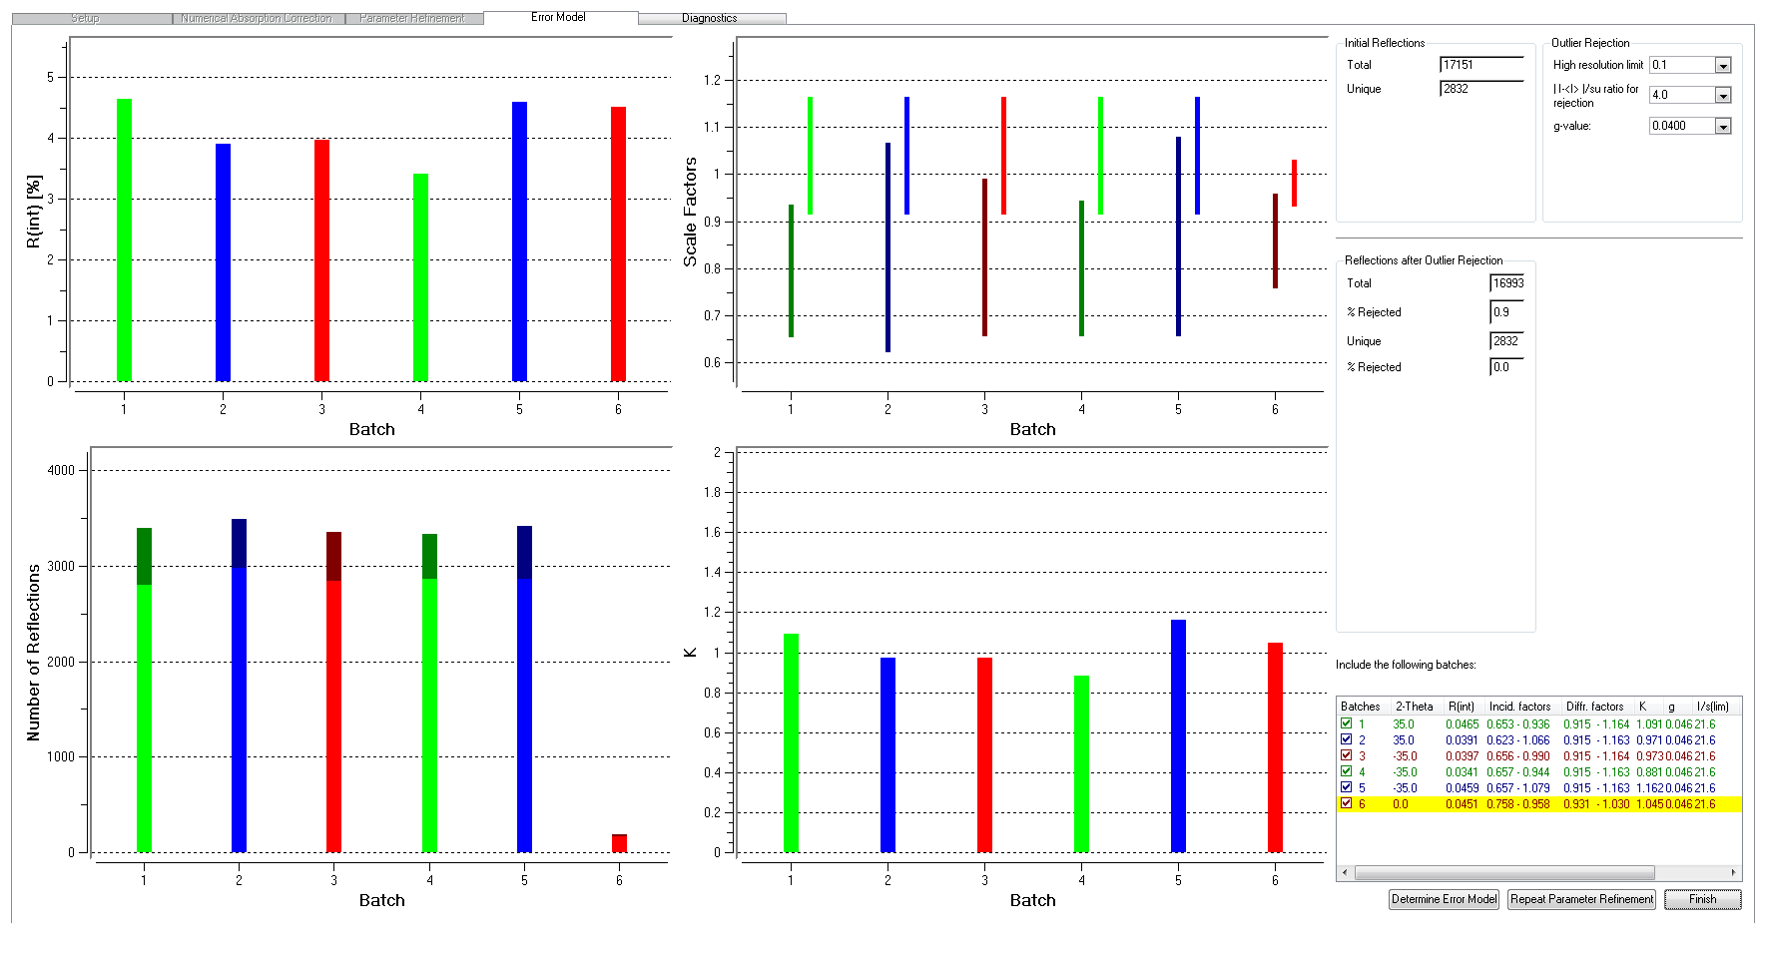
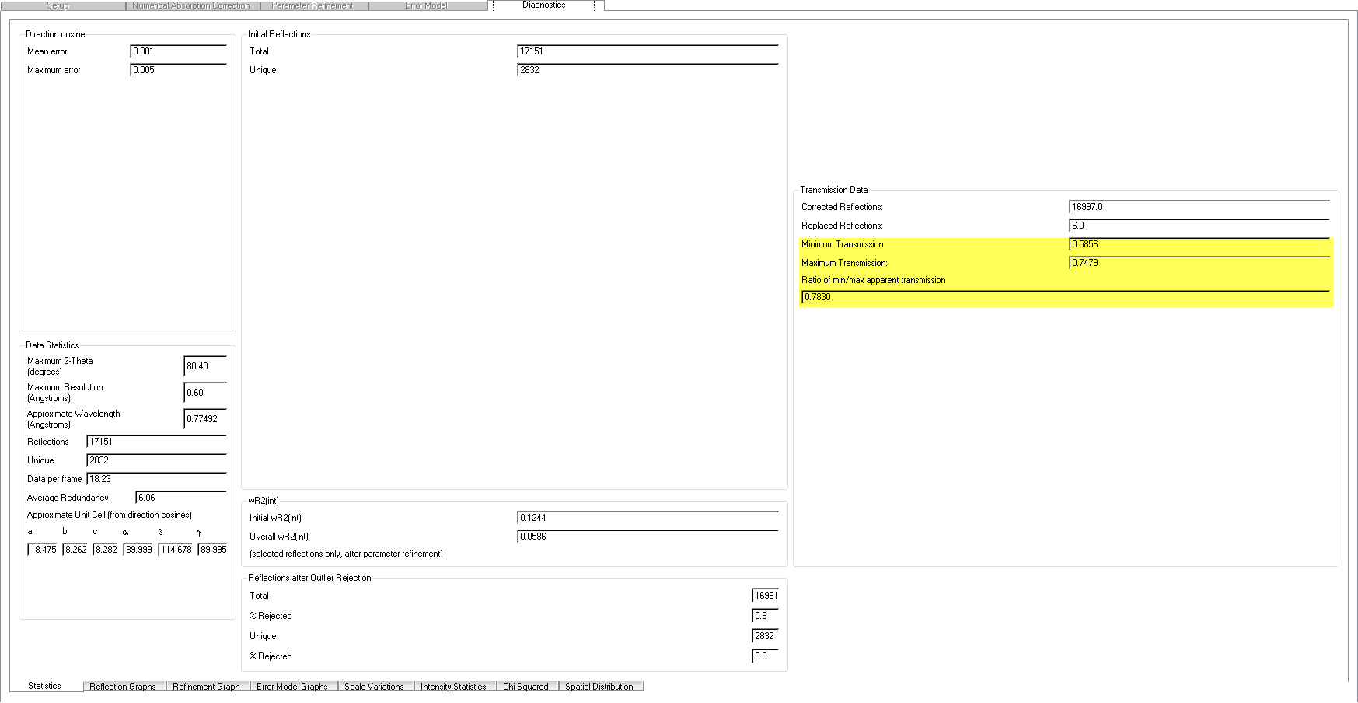
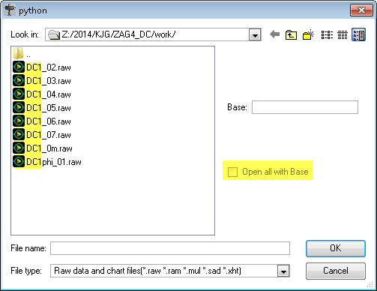
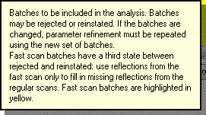
Absorption Correction
APEX2-Scale
Notes:
Make sure to adjust the restrain esd for scale factors and absorption type if you have strong absorbers or heavy metals. Recommend restraint esd: 0.02. Make sure to keep note of the max and min transmission values, as these will be necessary for your cif file later.

Slide 20
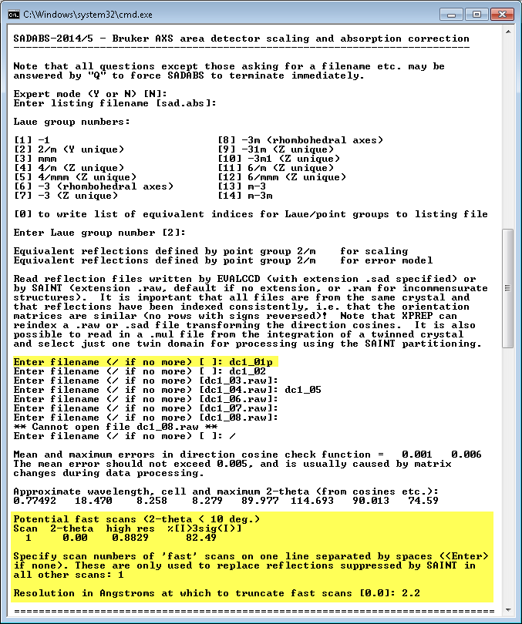
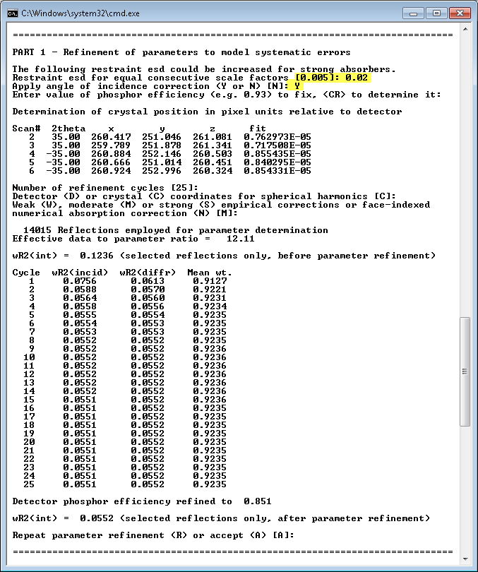
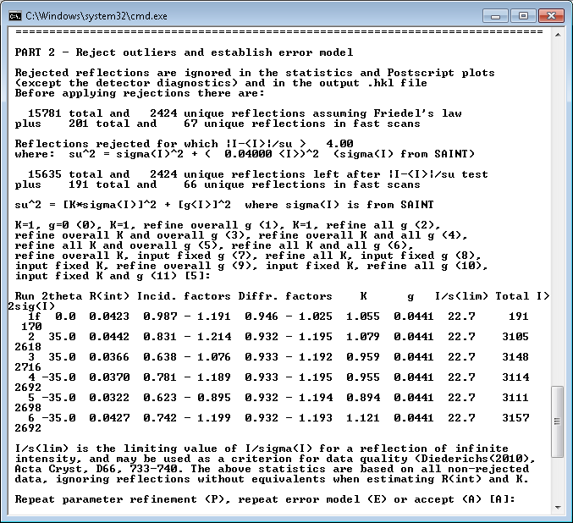
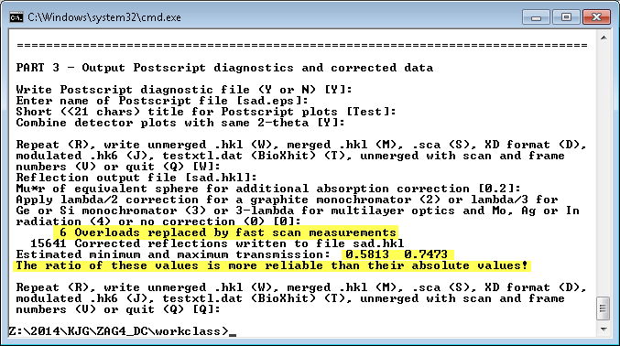
Absorption Correction
Command Line – SADABS
Divided into 3 parts
Input of data and modeling of absorption and other systematic errors.
Error analysis and derivation of ‘correct’ standard uncertainties for the corrected intensities.
Output of Postscript diagnostic plots and corrected data.
!!Almost all answers can and should be entered with <ENTER>!!
Notes:
I recommend running sadabs from the command line over using the GUI. It is required for good synchrotron data processing. Make sure to answer “YES” for angle of incidence correction when using synchrotron data or if you have extremely intense reflections. Make sure to keep note of the max and min transmission values, as these will be necessary for your cif file later. To run sadabs from command line, navigate to your work folder and type “sadabs”.

Slide 21
Absorption Correction
Command Line – TWINABS
Similar to SADABS; however, only can be run from command line.
When integration is run with more than one component, it produces .mul files, these are the same as .raw files but have batch numbers to identify multiple components. TWINABS uses these.
TWINABS will produce two files, an HKLF 4 and HKLF 5 file.
It is important to run your data through XPREP before using TWINABS to determine whether or not there is a change in orientation of your unit cell. TWINABS will need this.
!! AS WITH SADABS, <ENTER> IS USUALLY THE BEST ANSWER!!

Slide 22
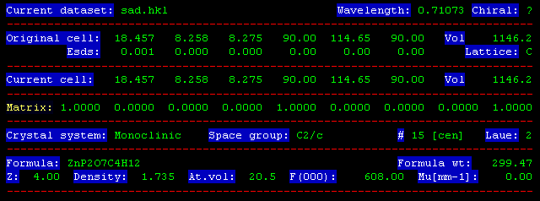
XPREP
XPREP is primarily a tool for setting up the files to continue forward with structure solution and subsequently refinement. (i.e. *.ins creation)
One very important file is created unknowingly by XPREP, the *.pcf file. This file contains useful items for insertion into your completed *.cif file.
Pay attention to the header before and after you run through the program, make sure if your axes have changed around, you are aware of this.
A *.prp file is also created, which is a summary of what you did in XPREP.

Slide 23
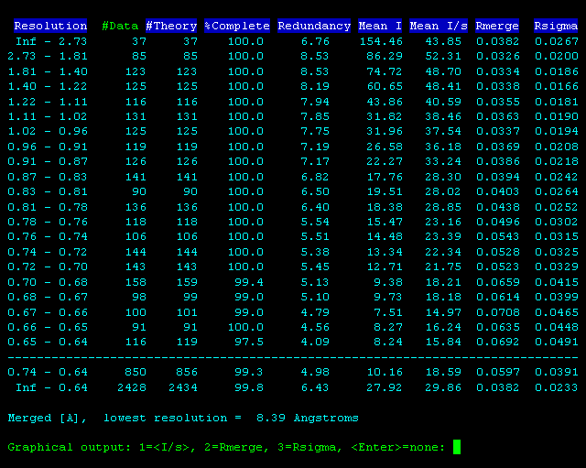
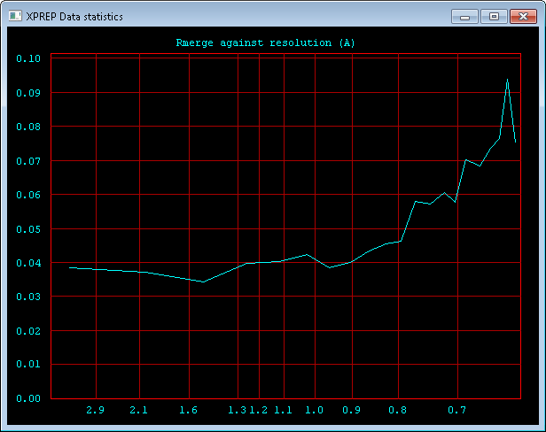
XPREP
Determining resolution
Mean I/s > 2
Rmerge > 0.25
*If resolution <> 0.83, Rmerge criteria can be more flexible. (i.e. ~0.3)
Make sure data quality isn’t drastically going up and then down reevaluate your data to see if there is something wrong.
!!THIS SHOULD BE DONE BEFORE FINAL INTEGRATION!!

Slide 24
Structure Solution
Structure solution is the first step of determining the structure of a crystal; however, the majority of the work done on the structure is actually structural refinement.
The solution would in essence be the inverse FT to generate a density MAP from the diffraction pattern; however, because we cannot measure the phase information of the structure factors, we have to use other methods to “guess” the phase.
Peak picking algorithms identify density maxima and present them for visualization in an easy manner.

Slide 25
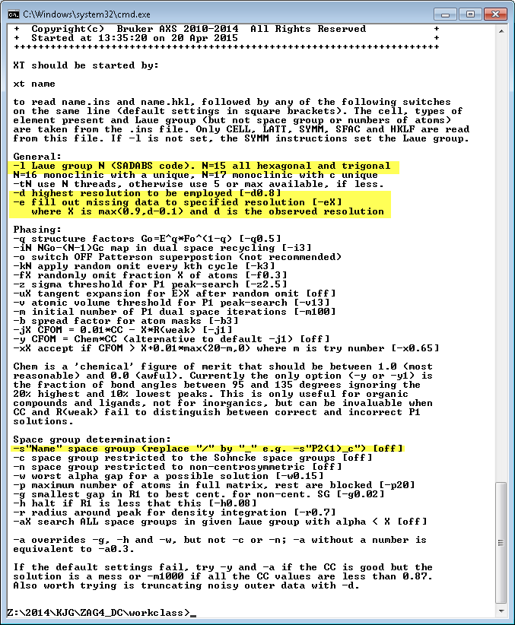
Structure Solution
Command line – XT/XS
Two main programs in the Bruker Suite for initial structure solution
XS – direct methods structure solution
XT – newer intrinsic phasing method
Extremely powerful, contains a ‘free lunch’ algorithm
Notes:
If data quality is poor and an initial solution is difficult with XT try some of these flags from the command line. One thing to try is lowering your employed resolution (-d flag) and increasing or decreasing the calculated data resolution (-e) (i.e. try –d1.3 –e1.0 to trim your data to 1.3 and calculate data to 1.0) this calculated data is random, not real, it was found that this often gives a better starting place than trying to calculate the real values.

Slide 26
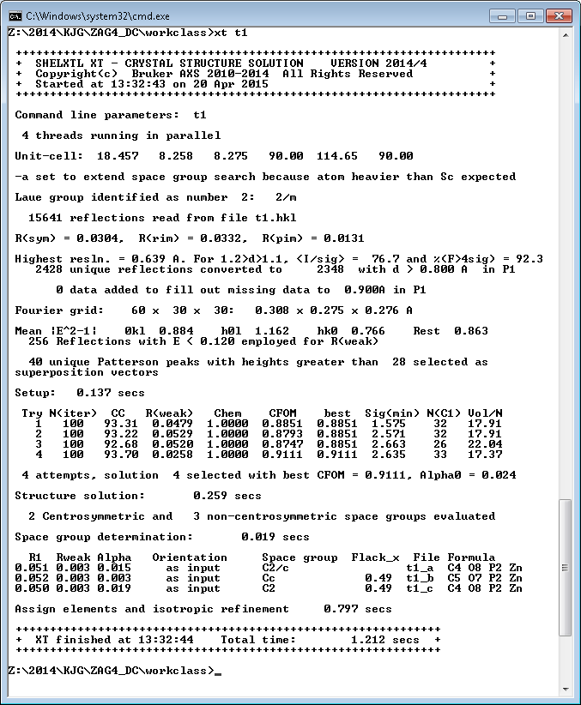
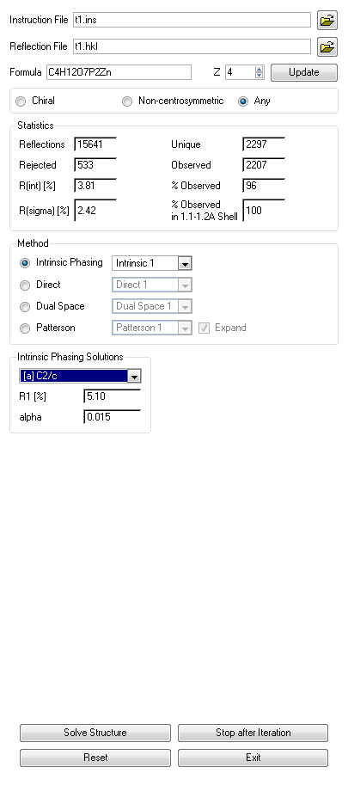
Structure Solution
APEX2 – Structure Solution – Intrinsic Phasing/Direct Methods
These are XT/XS respectively
Notes:
Make sure to look at all of the solutions provided by XT, not just the first. Convince yourself which is the correct.

Slide 27
Final Comments
R1 is not everything
Not every crystal will be publishable for every task
Don’t be afraid to ask for help
Don’t spend weeks to months on a difficult refinement that could have been fixed by correctly collecting data… however… don’t be surprised when a refinement takes weeks to months.

